Slide 1
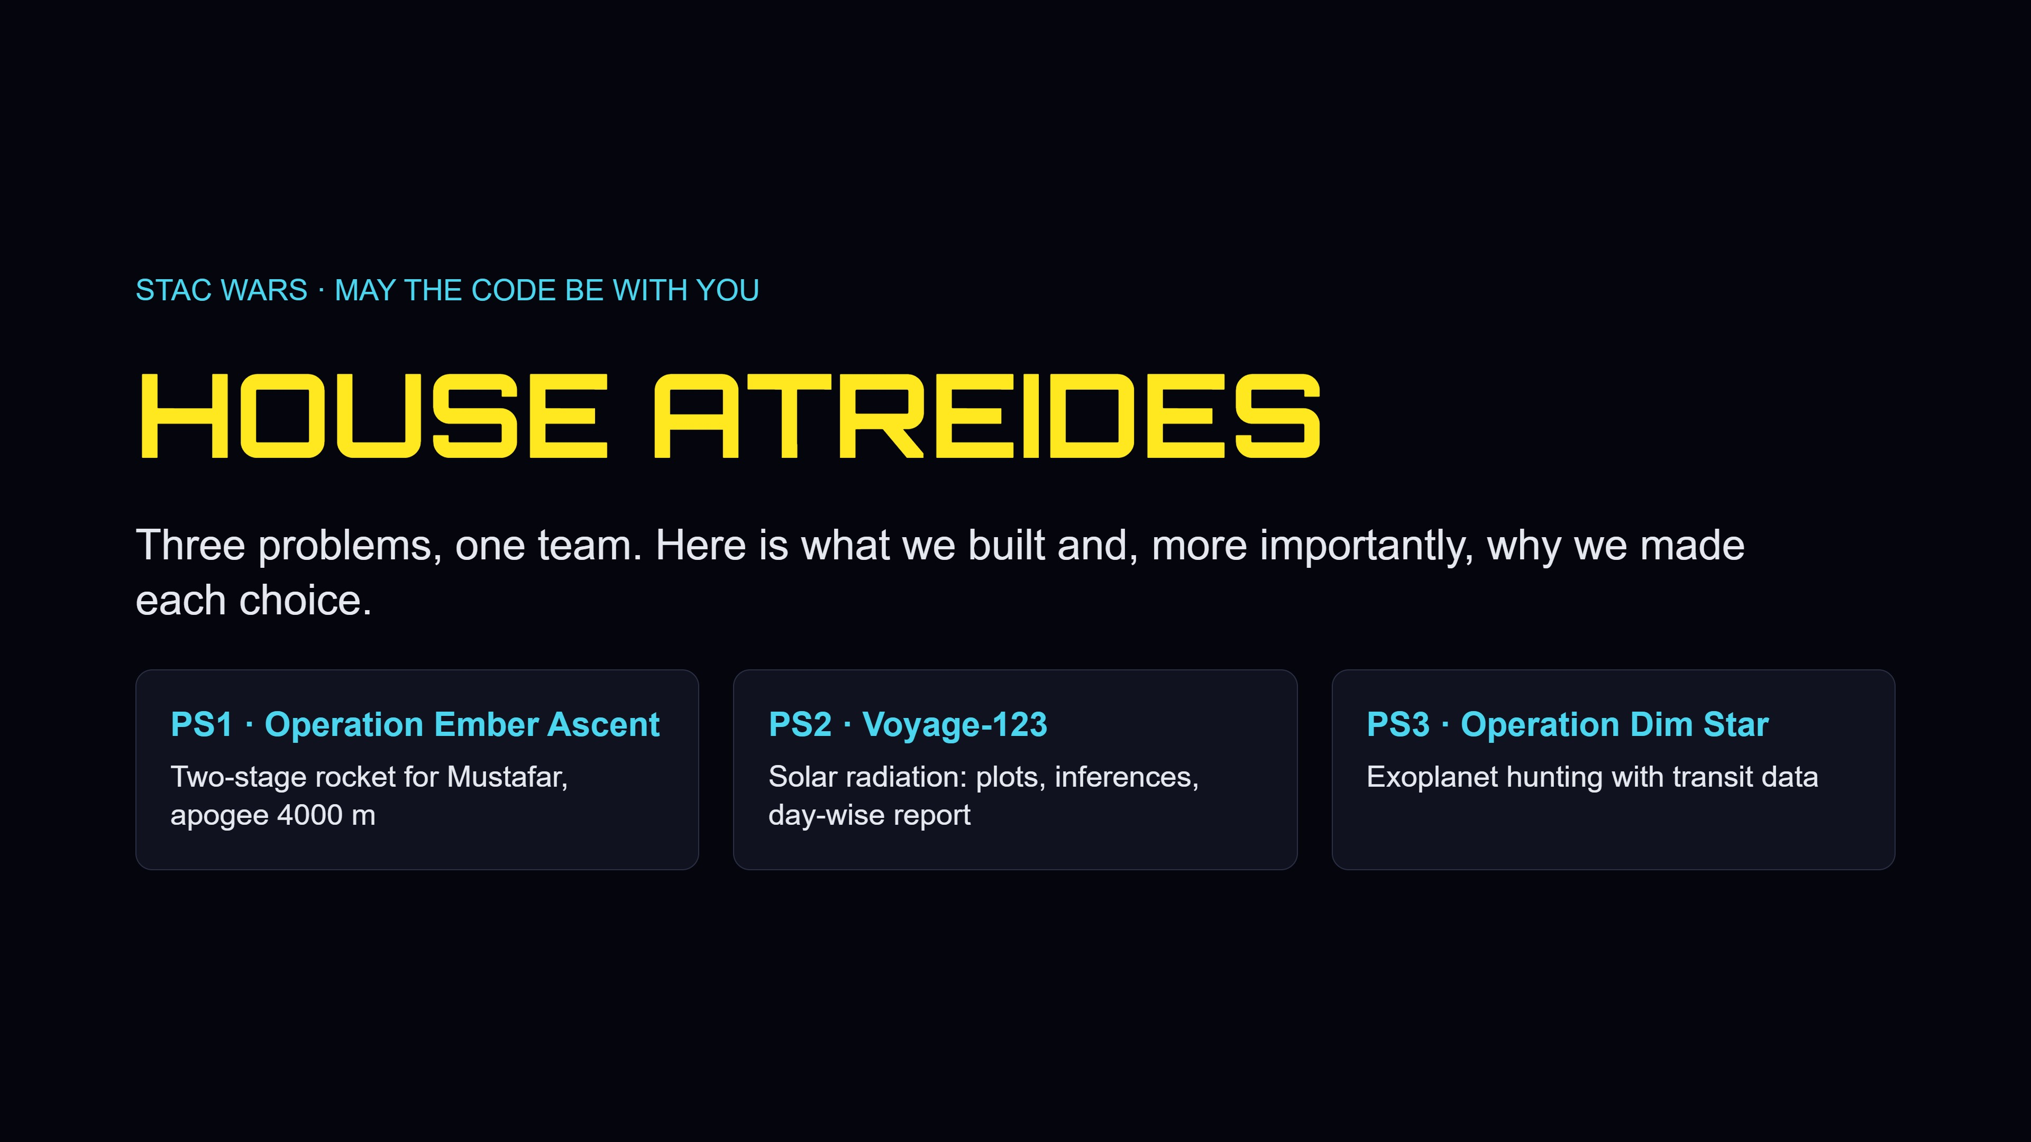
Notes:
Quick intro: three problems from STAC WARS. For each one we will say what we did, but mostly why we did it that way.

Slide 2
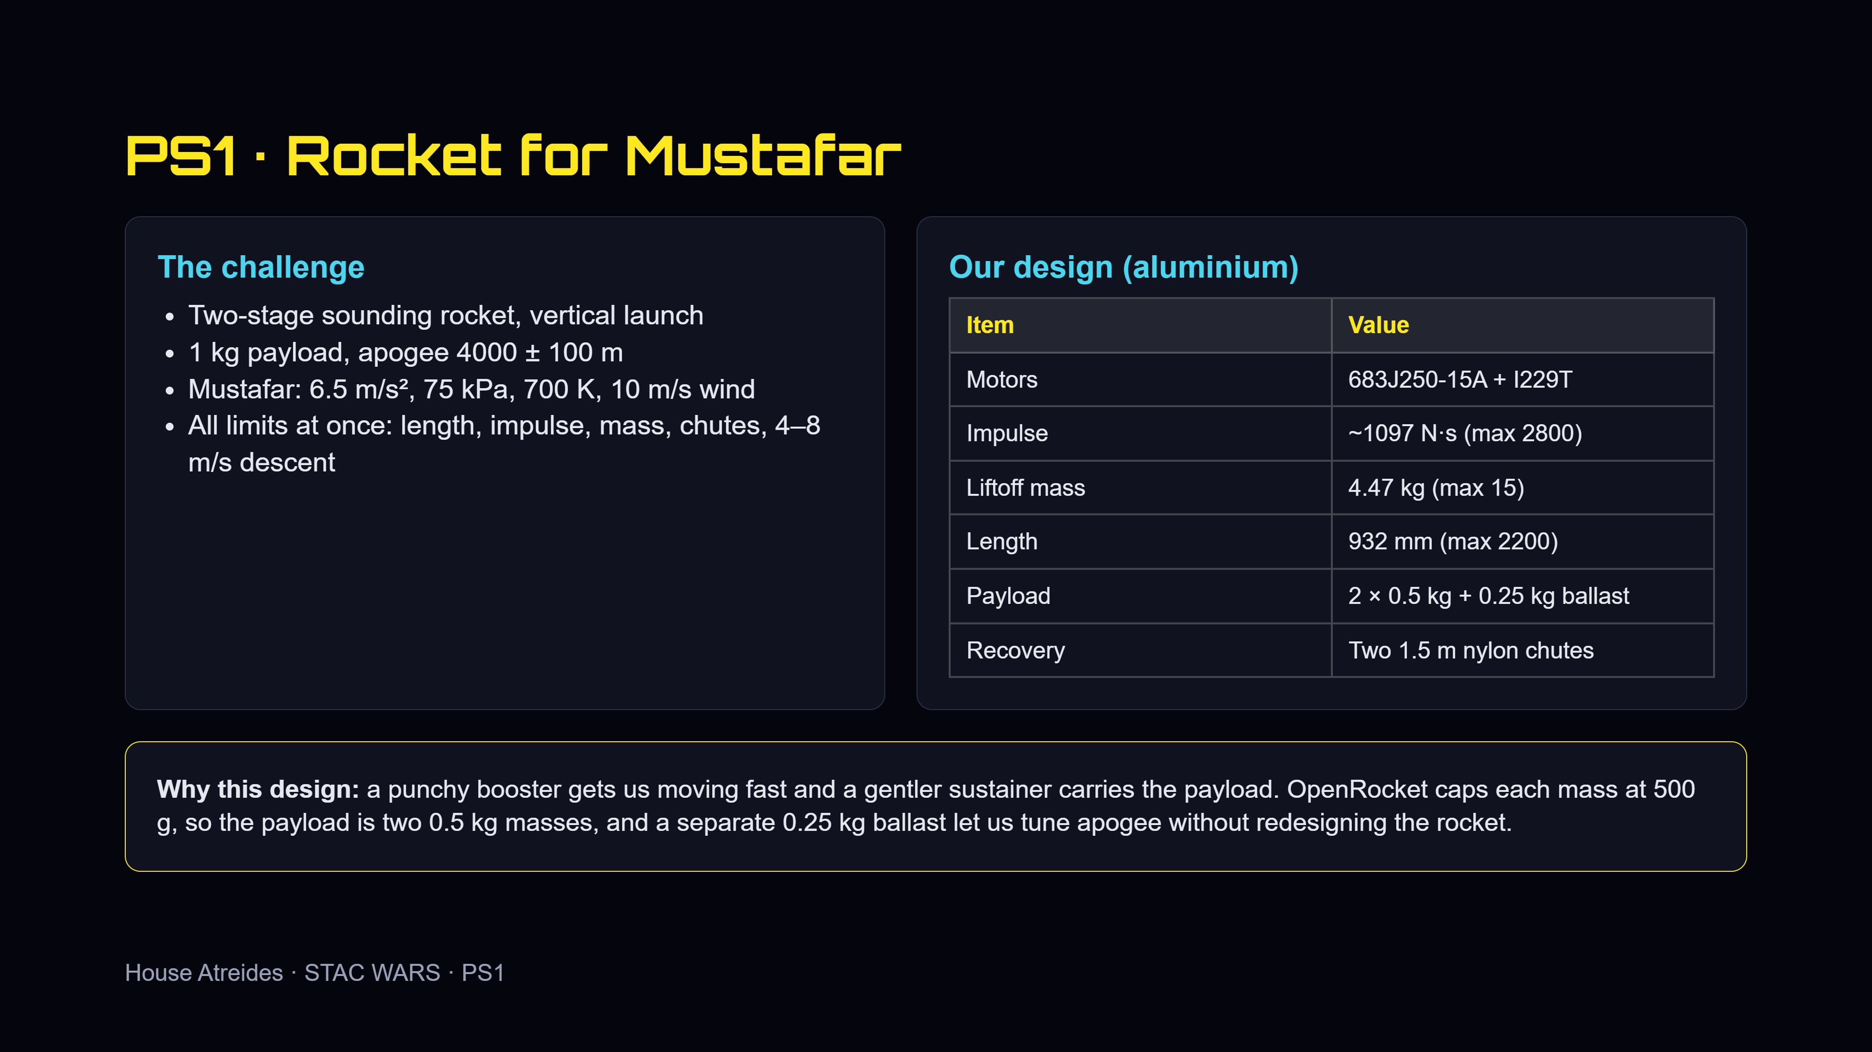
Notes:
Start with the constraints: two stages, 1 kg payload, 4000 m, and very different air. Then explain the thinking: booster for a fast start, sustainer for the rest, two 0.5 kg masses because of the OpenRocket limit, ballast to fine-tune apogee. Body material is aluminium.

Slide 3
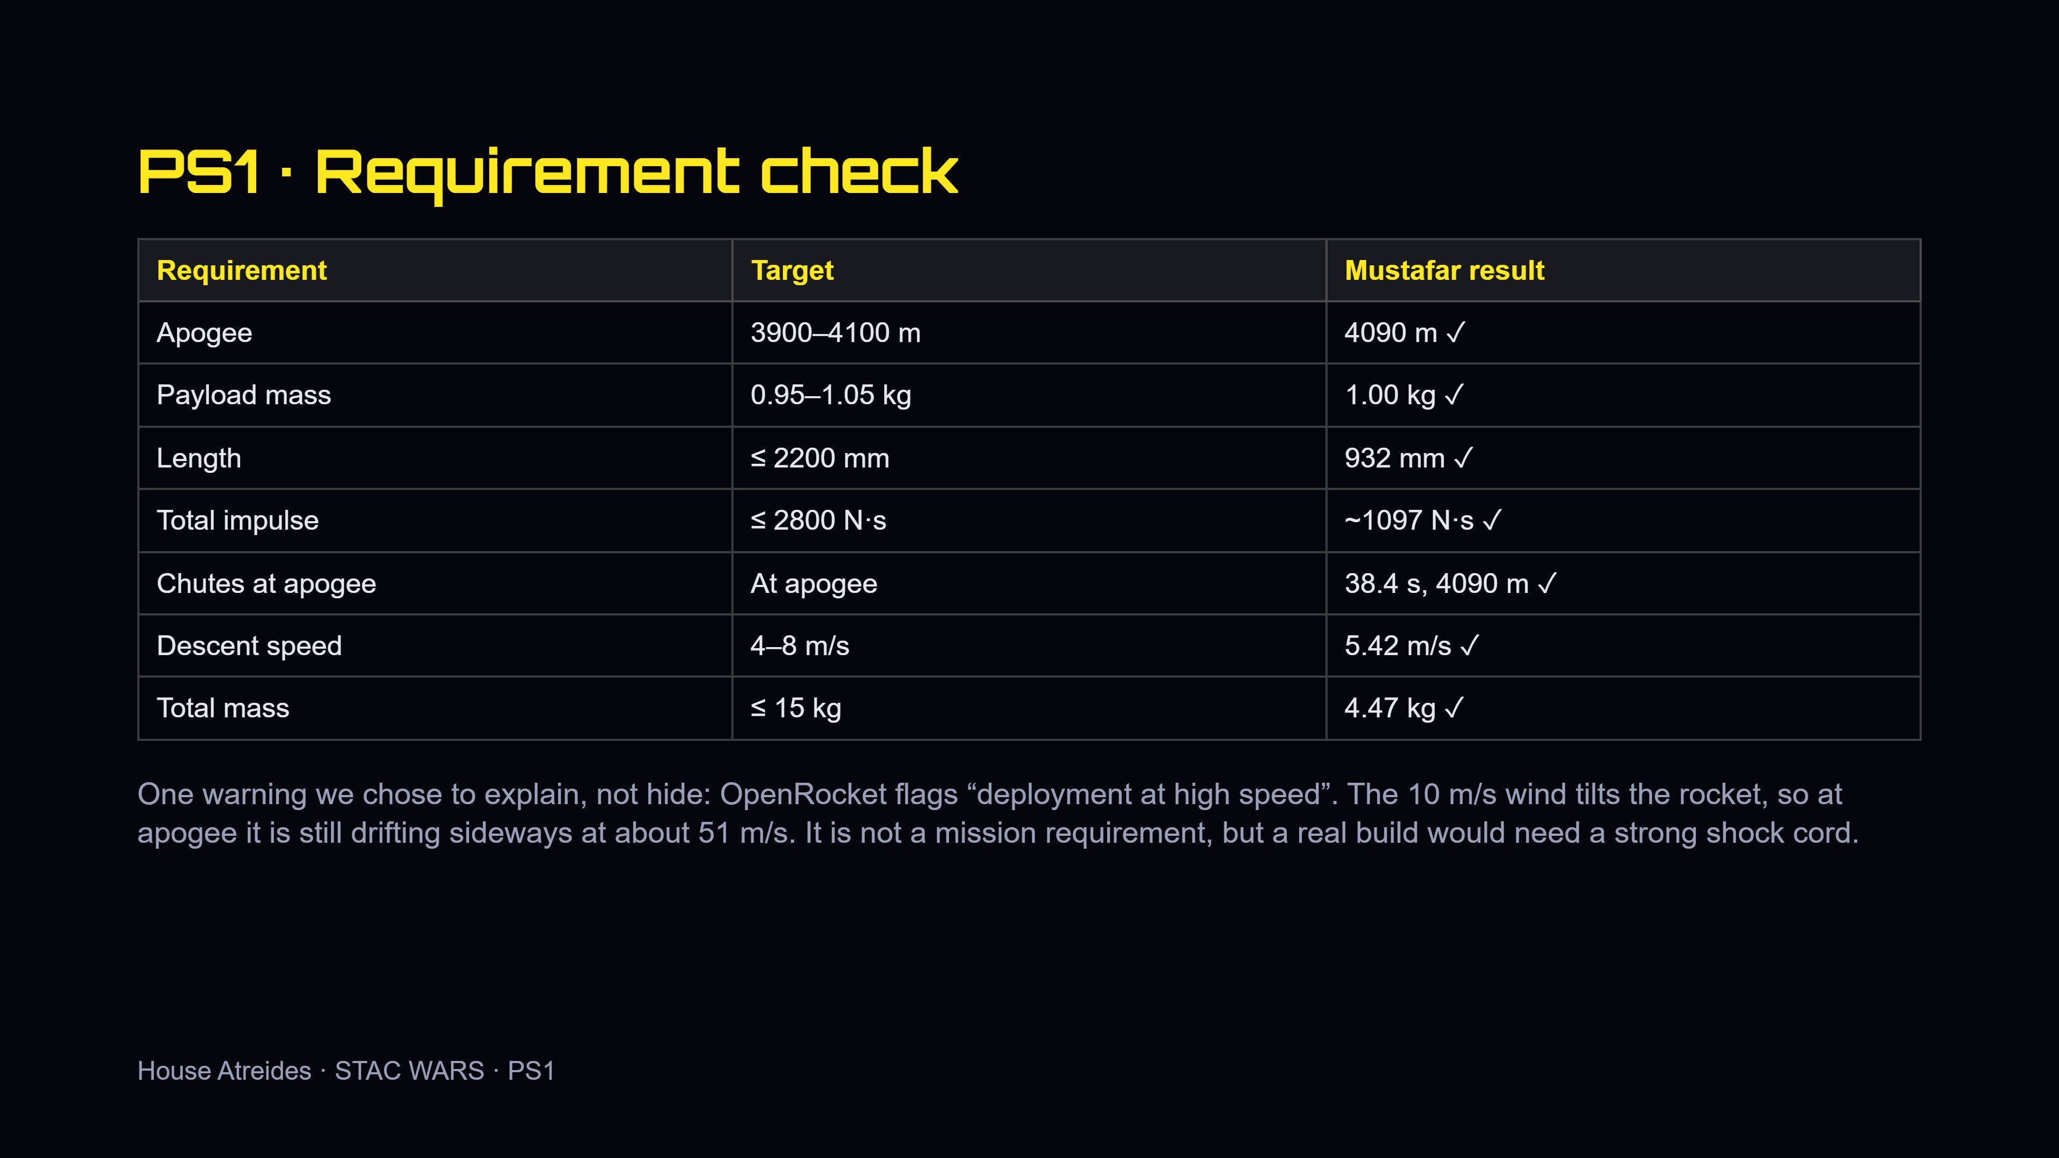
Notes:
Every requirement ticks. Be upfront about the high-speed deployment warning: the wind tilts the rocket, so it is still moving sideways at apogee. It is not a mission requirement, and we would reinforce the shock cord on a real build.

Slide 4
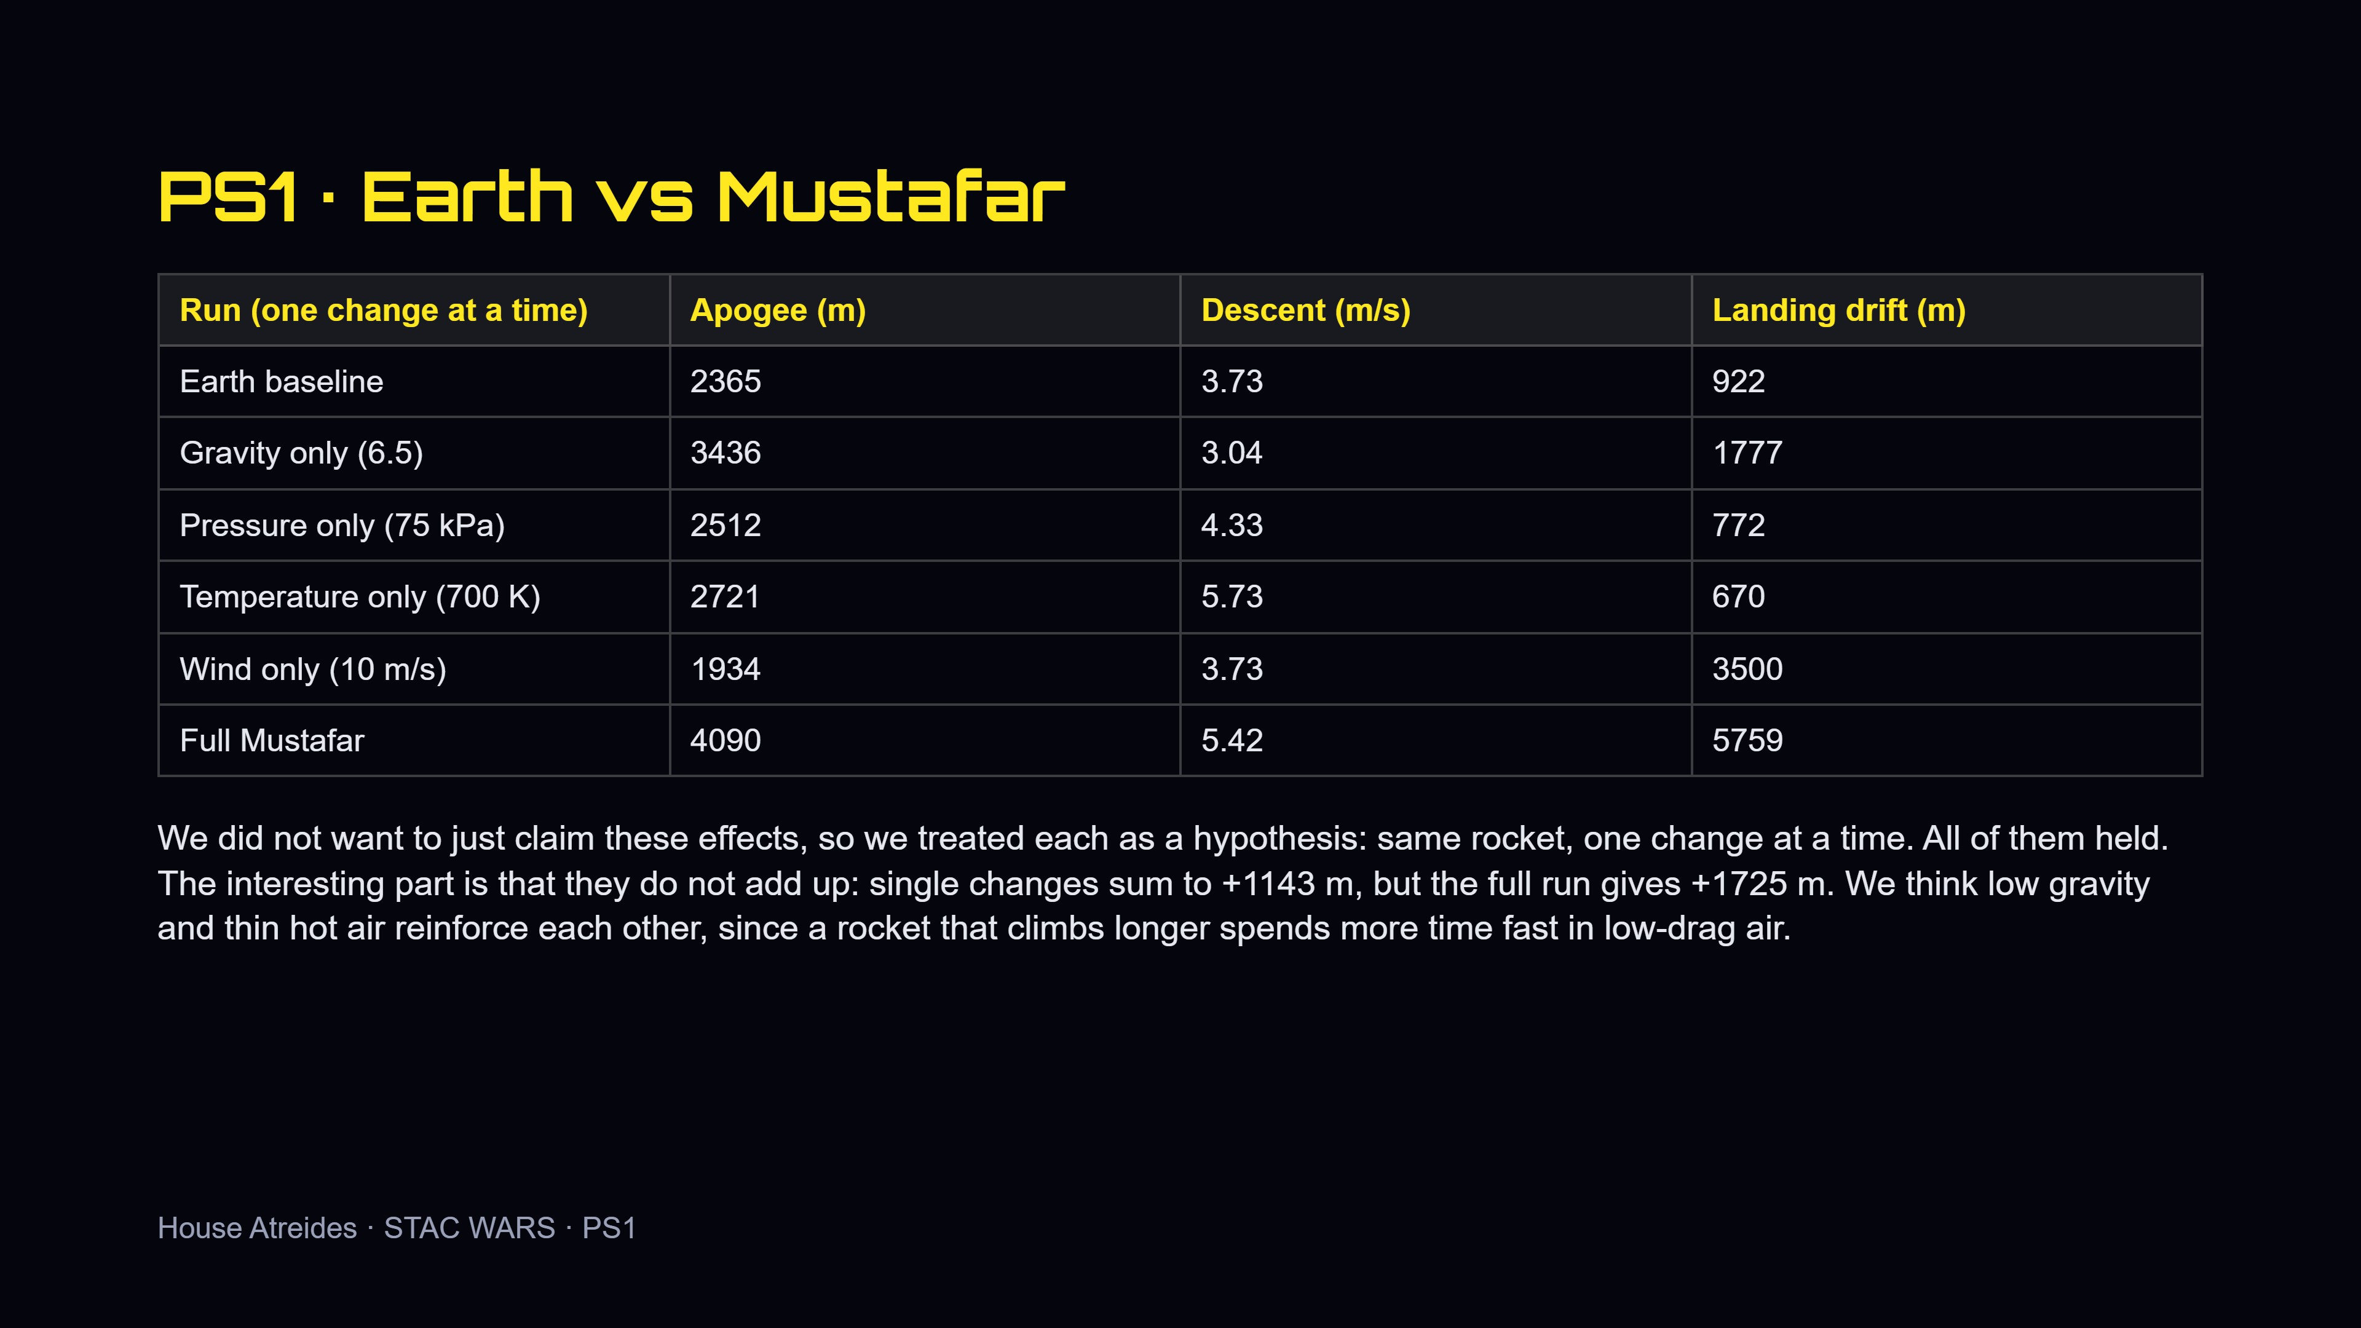
Notes:
We tested each effect separately instead of just asserting it. Read one row per change. Key message: the effects are not additive, and our explanation is that low gravity and thin hot air reinforce each other.

Slide 5
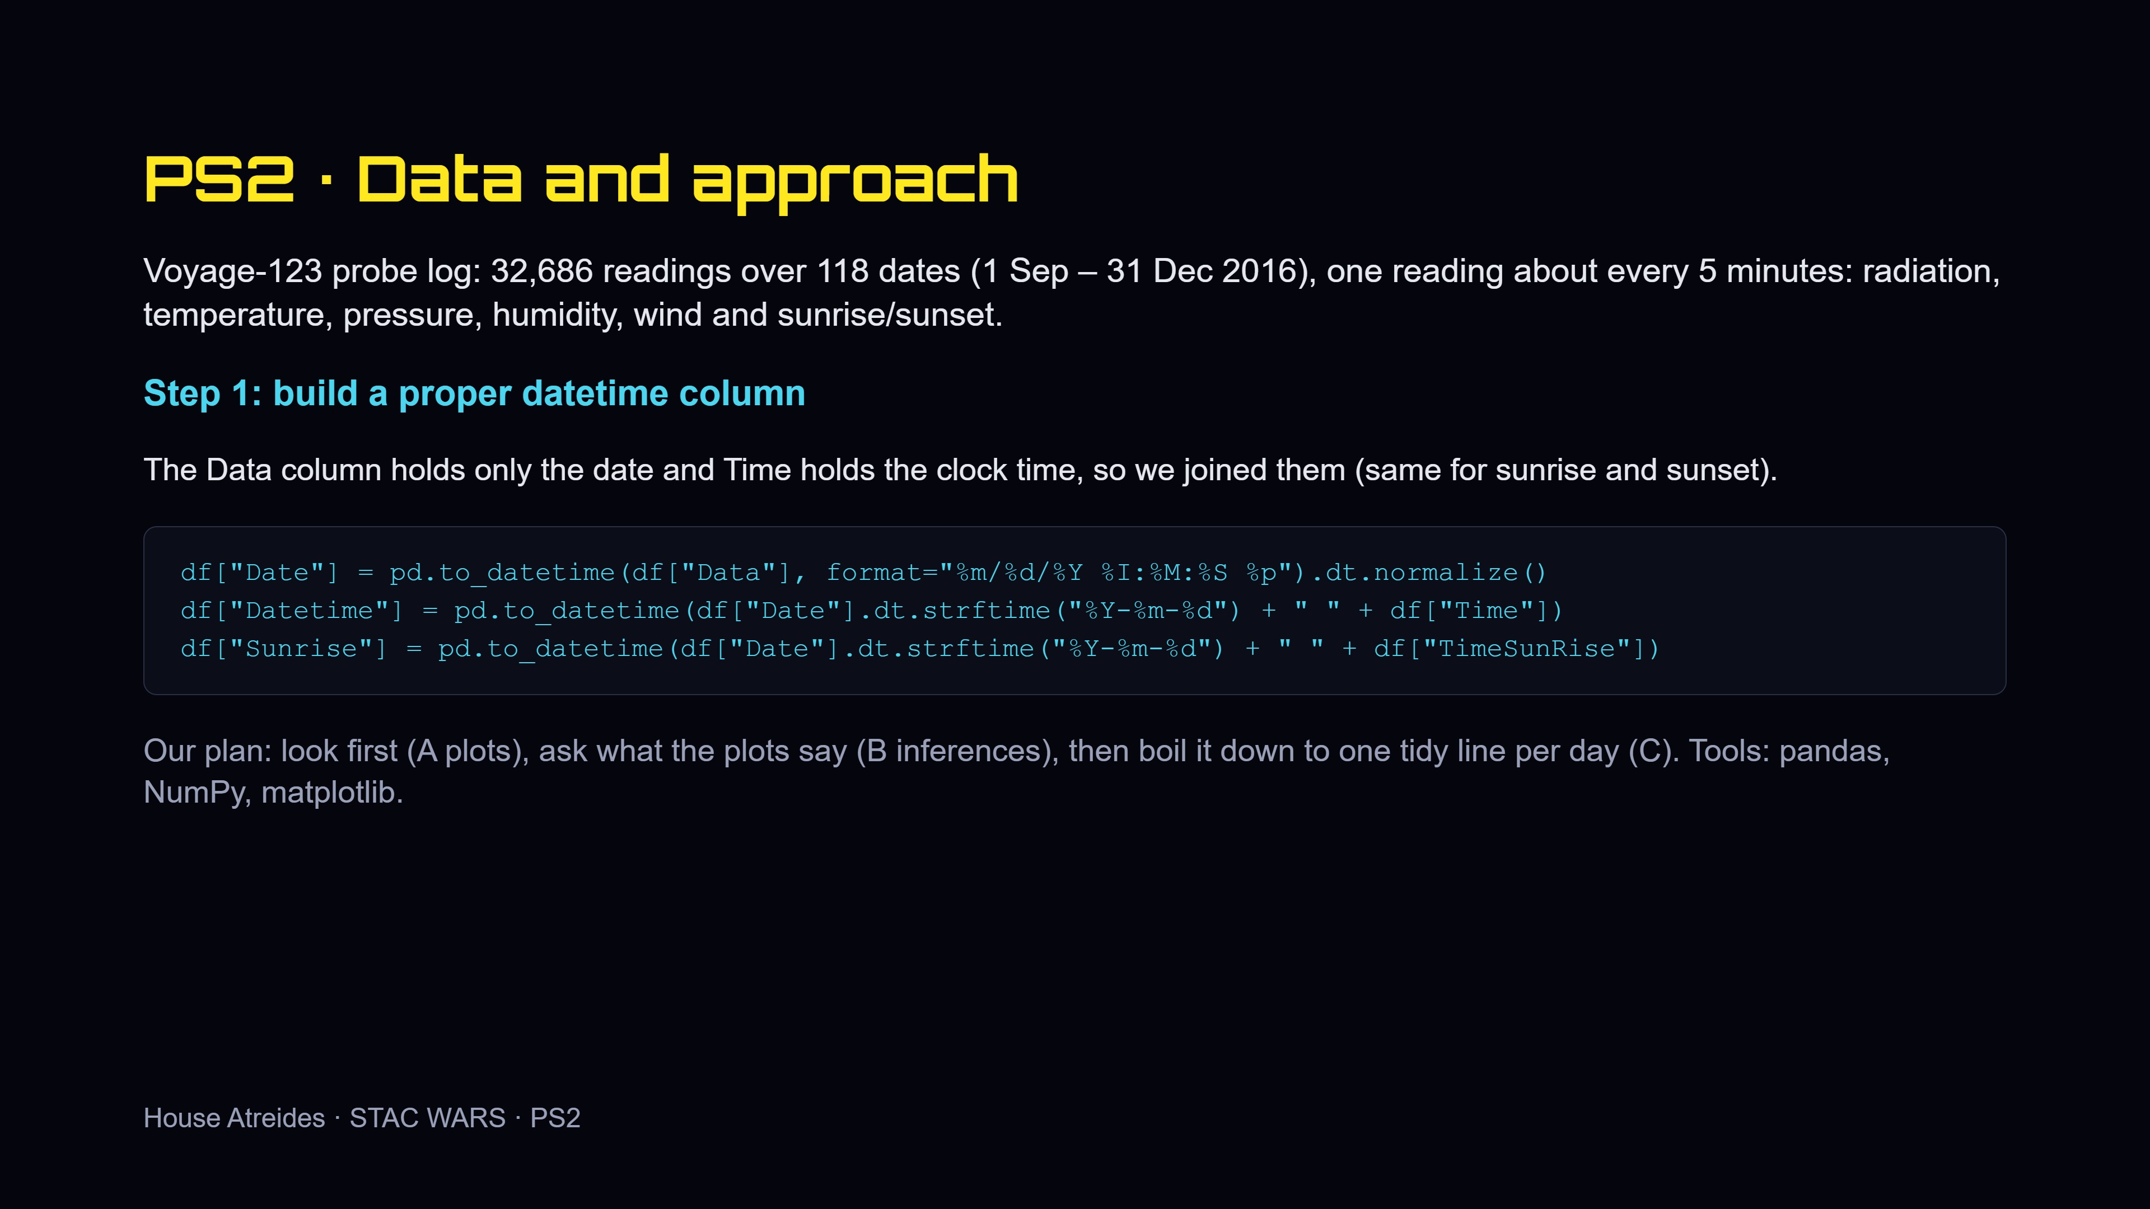
Notes:
The raw file had date and time in separate columns, so we fixed that first because everything else depends on it. Explain the code in one sentence: it joins the date and the clock time into one datetime.

Slide 6
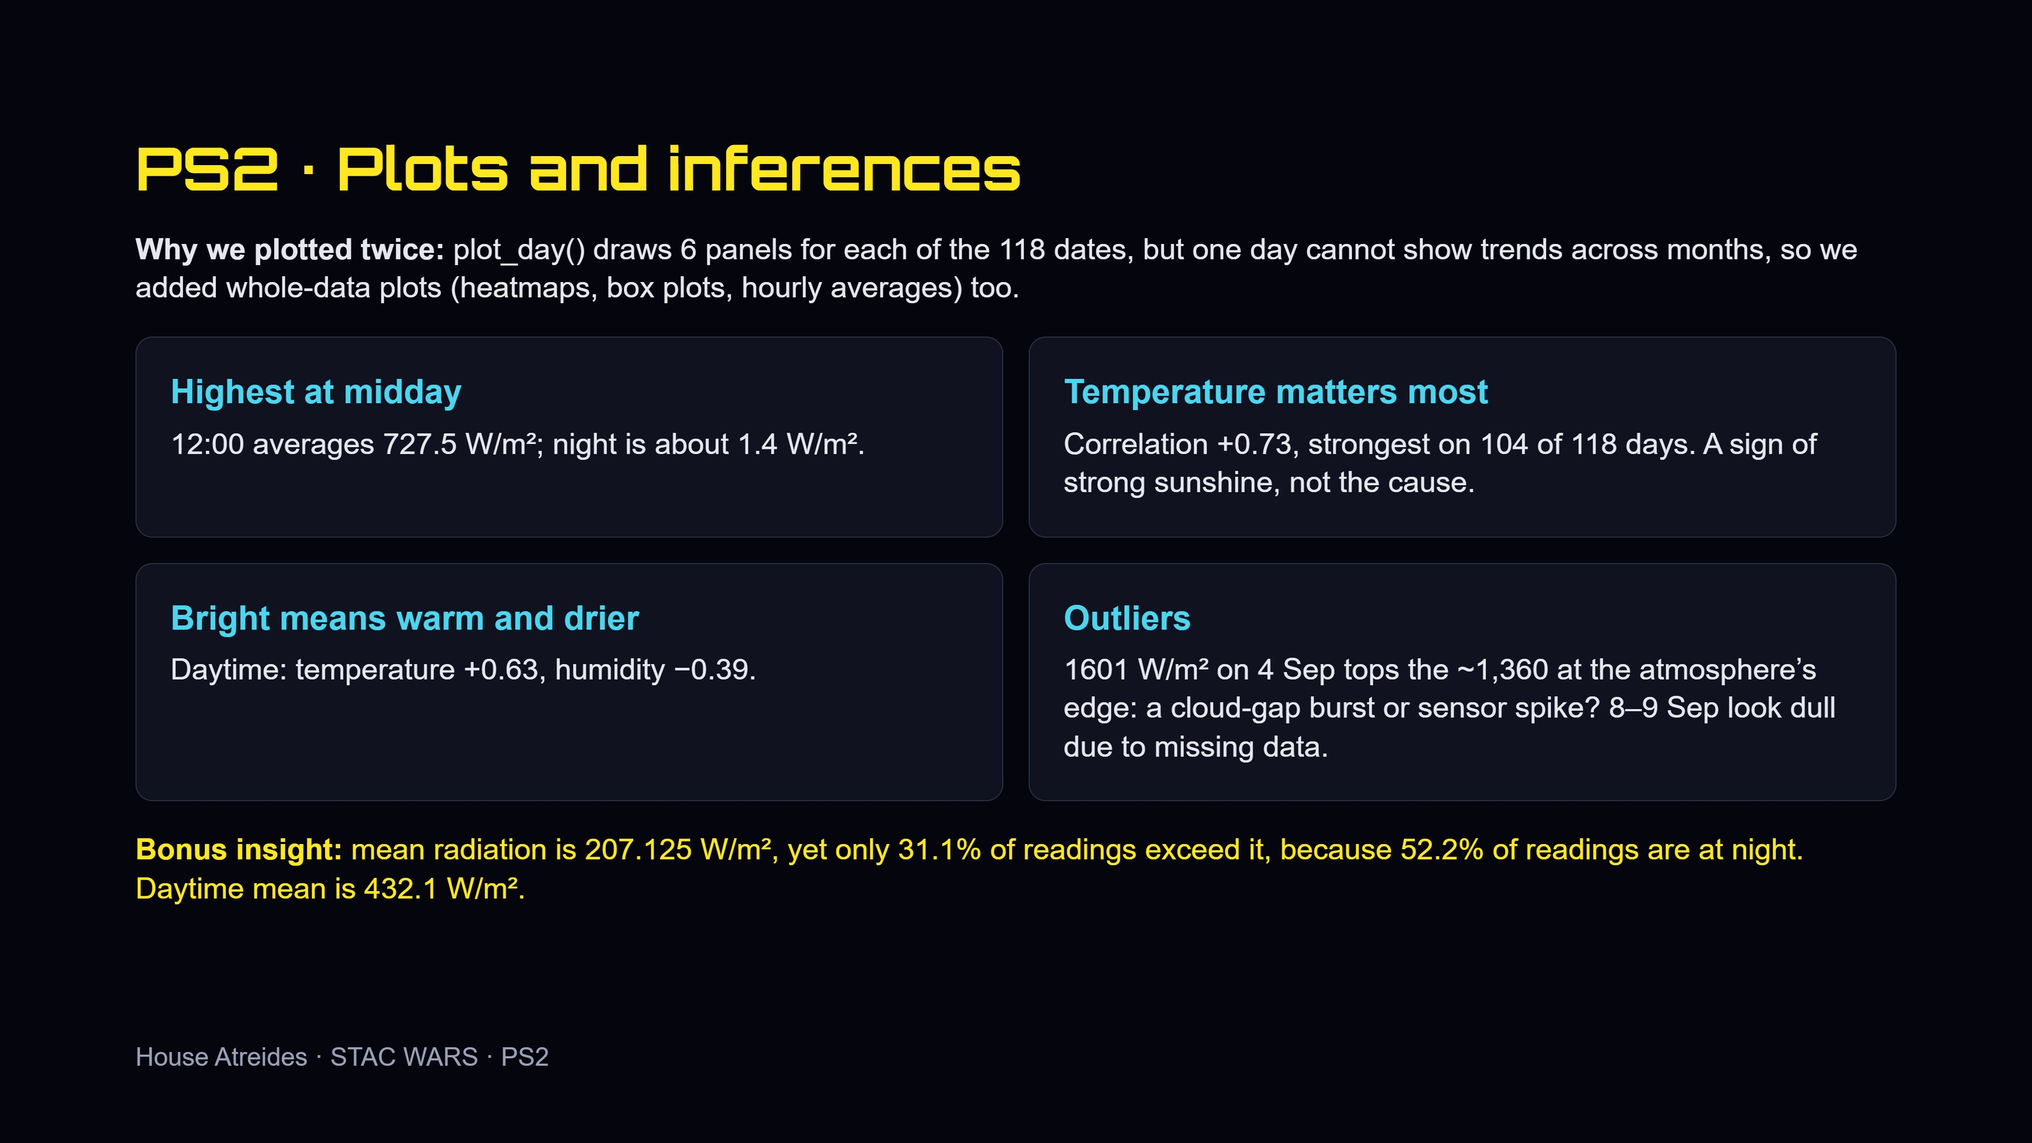
Notes:
Say why we made both per-day and whole-data plots. Then the four findings. Stress that temperature is a sign of strong sunshine, not the cause, and that the low averages on 8 and 9 September are missing data, not weather.

Slide 7
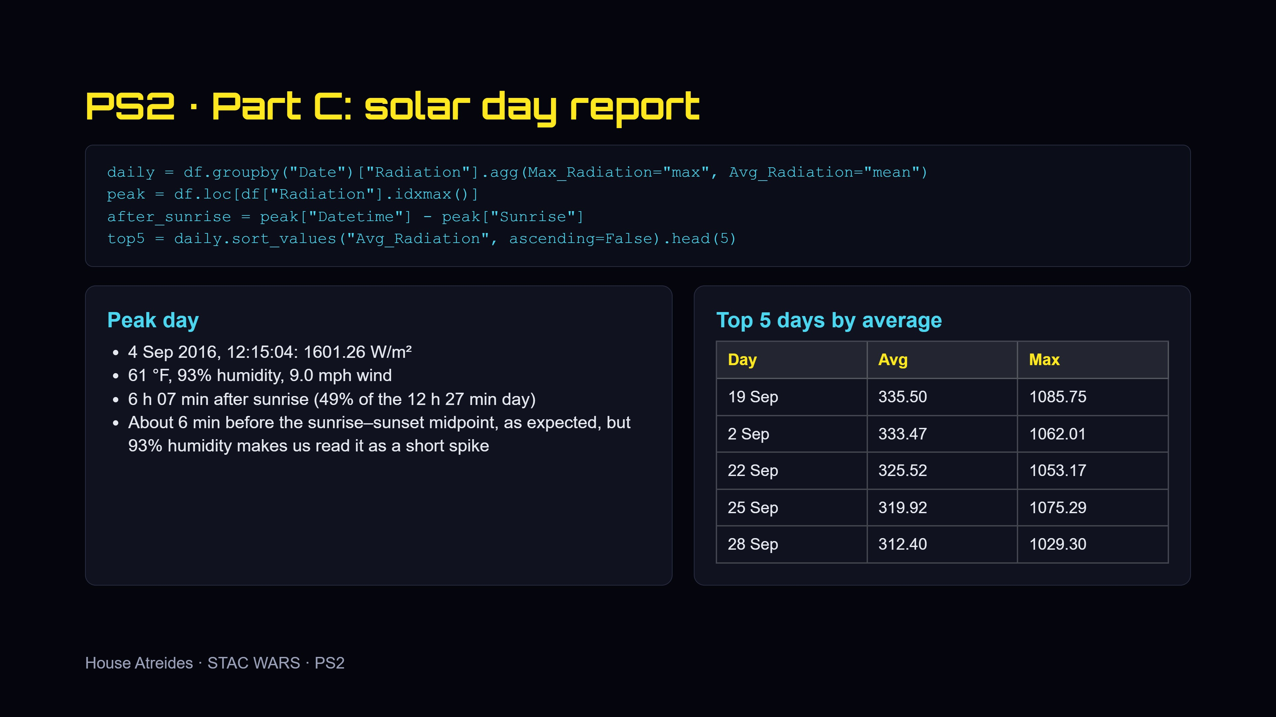
Notes:
In plain words: groupby gives one line per day, idxmax finds the brightest reading, subtracting sunrise gives the time after sunrise, sorting gives the top 5. The peak was 1601 W/m² on 4 September, 6 h 07 min after sunrise.

Slide 8
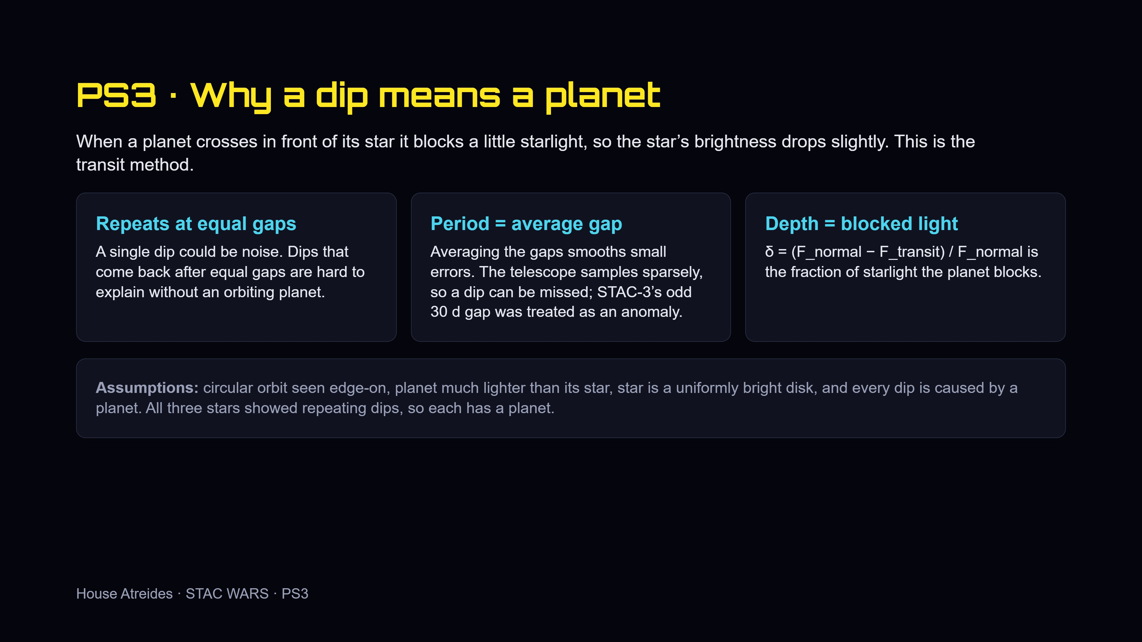
Notes:
Why a dip means a planet: repeating at equal gaps is hard to explain any other way. We average gaps to smooth errors, and we treated the odd 30 d gap on STAC-3 as an anomaly because sampling is sparse. Mention the assumptions.

Slide 9
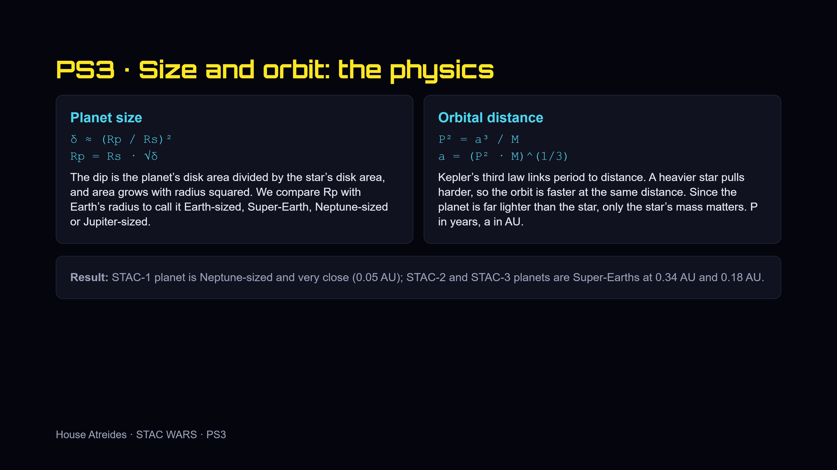
Notes:
Size: the dip is a ratio of areas, so depth is the radius ratio squared. Orbit: Kepler’s third law turns period and star mass into distance. Both rest on the assumptions from the previous slide.

Slide 10
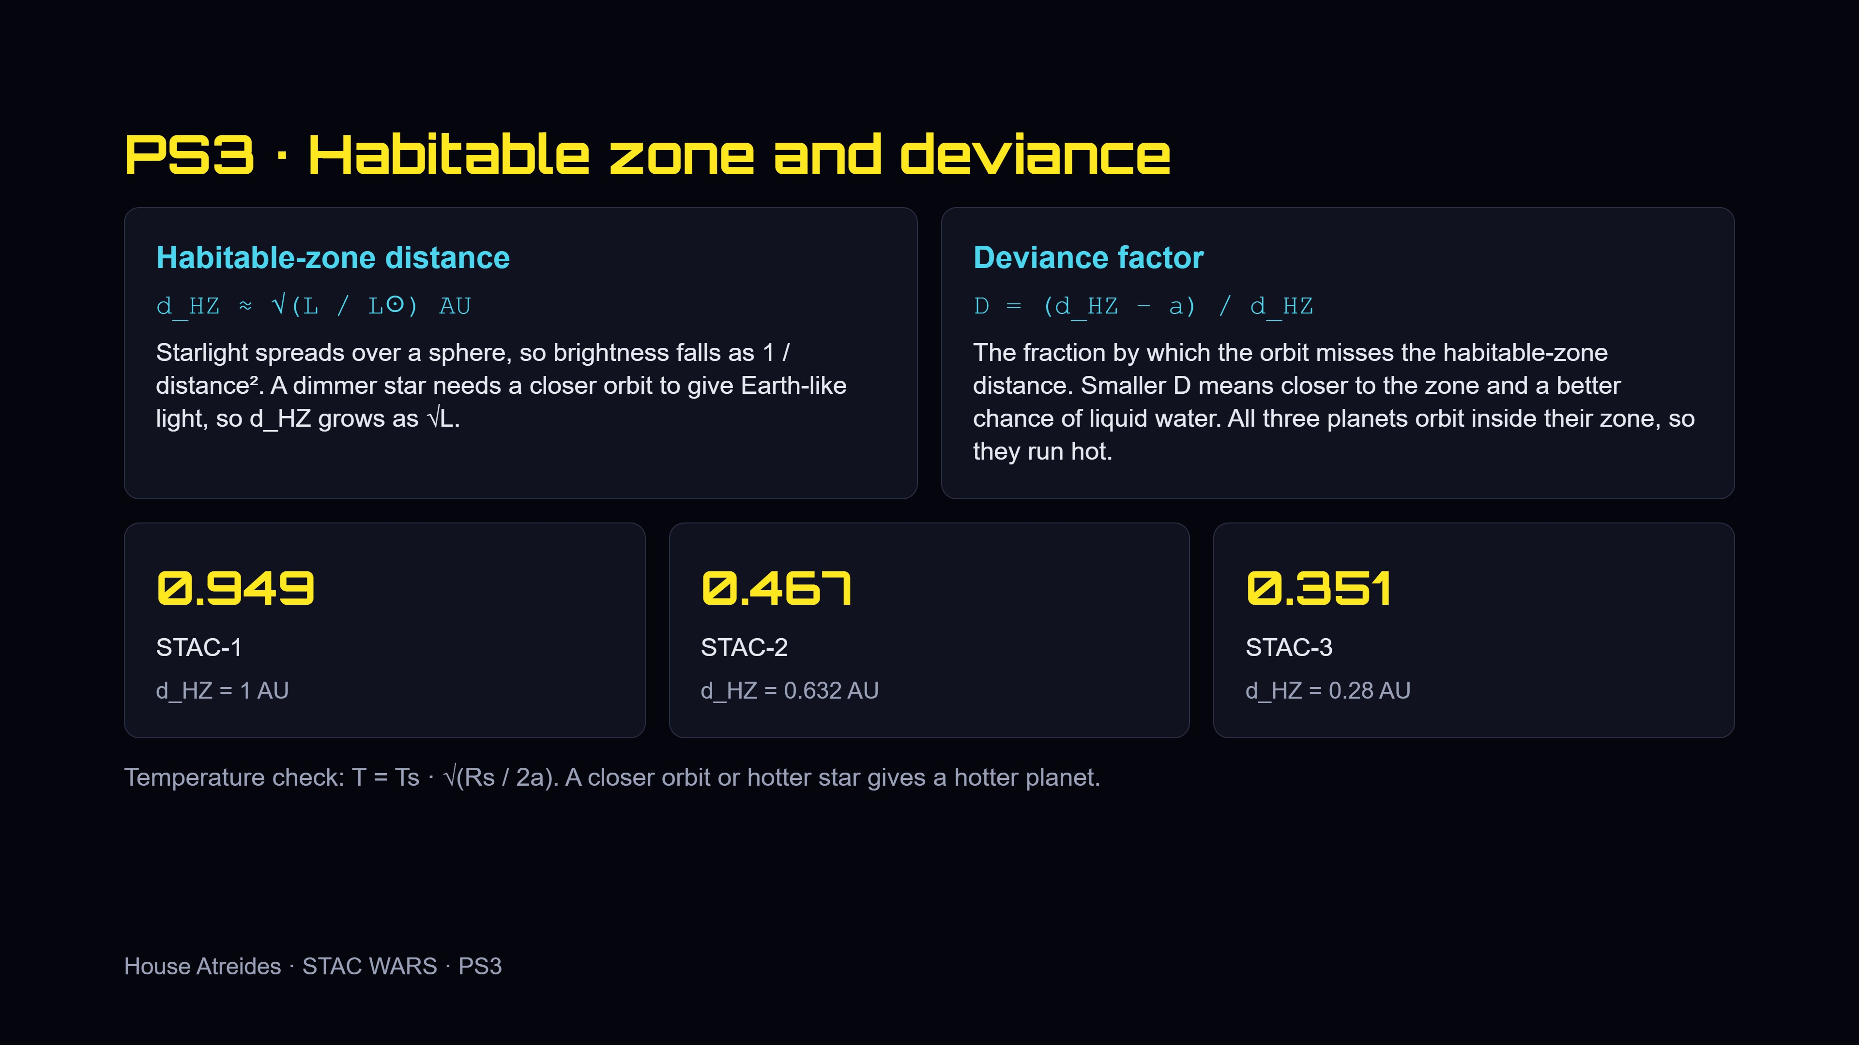
Notes:
Light spreads over a sphere, so a dimmer star needs a closer habitable zone. The deviance factor says by what fraction a planet misses that distance. Smaller is better. All three orbit inside their zone, so they run hot.

Slide 11
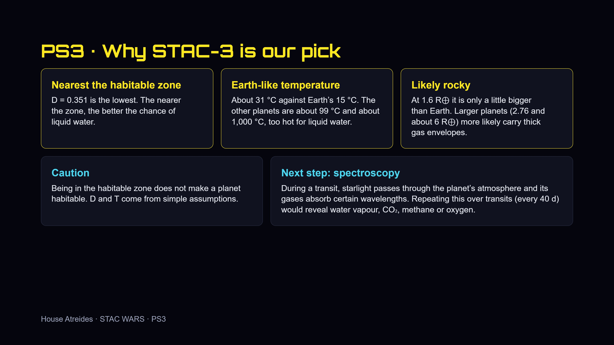
Notes:
Three pieces of evidence for STAC-3: nearest the habitable zone, Earth-like temperature, likely rocky. Then be honest about the caution, and explain why spectroscopy is the next step.

Slide 12
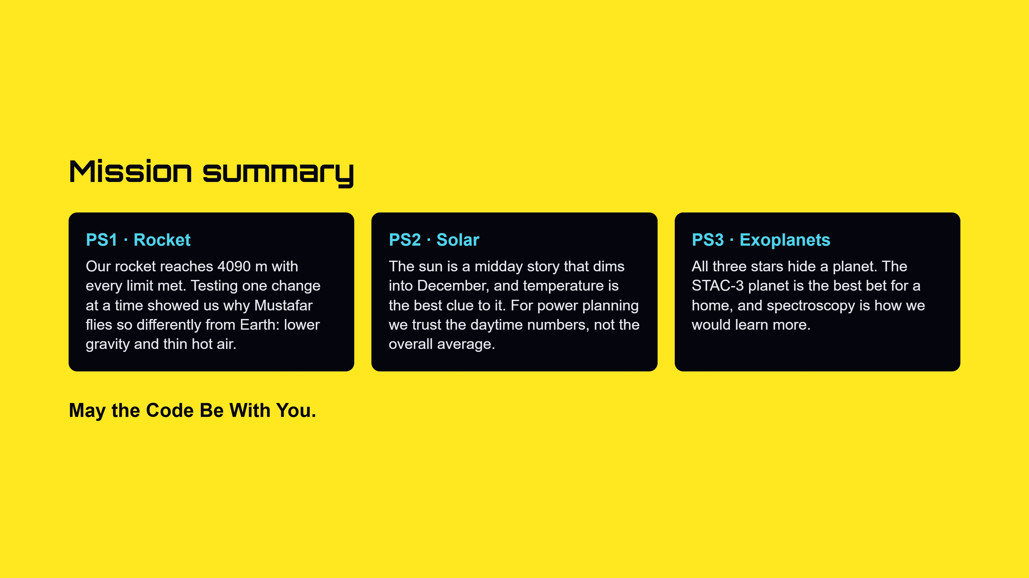
Notes:
One sentence per problem: the rocket flew and we understand why, the sun follows a midday pattern, and STAC-3 is our best bet for a new home.

